Slide 1

Accelerating Abnormal-Behavior Detection in Surveillance Video via Deep Neural Networks &Group Testing Methods

Slide 2
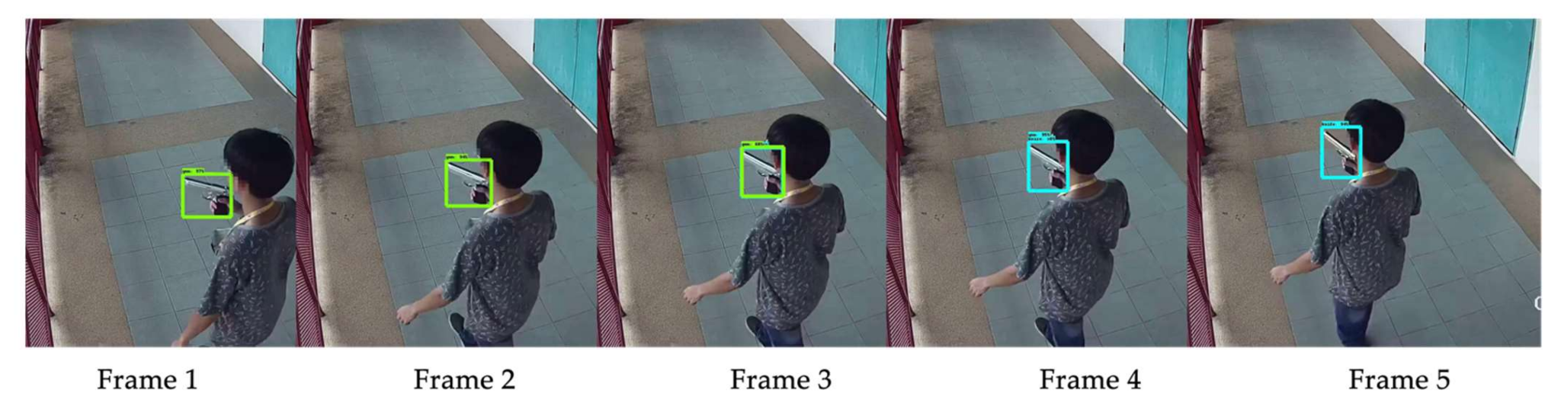
Motivation: The Firearm Detection Problem in CCTV
Challenge: Efficiently detecting abnormal behavior within vast surveillance footage.
Target: Detect and locate this in hours of footage.

Slide 3


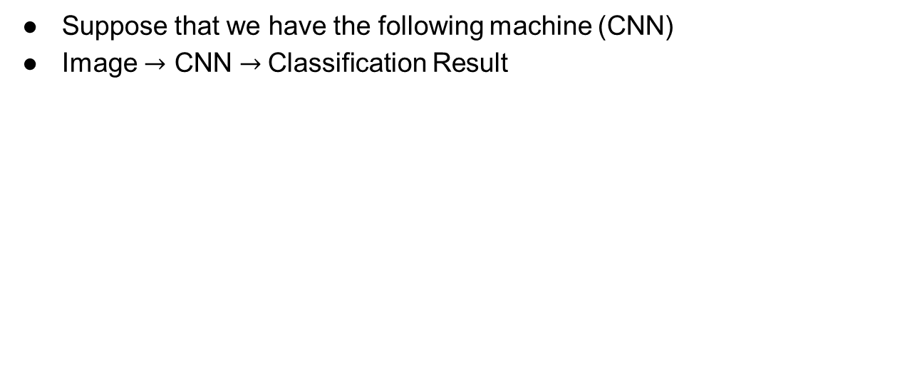
Motivation
Suppose that we have the following machine (CNN)
Image $→$ CNN $→$Classification Result
CNN
Convolutional Neural Network
Image
Firearm? (YES/NO)

Slide 4
Motivation
Can we exploit this machine to look for firearm in CCTV (videos)?
CNN
Convolutional Neural Network
Image
Firearm? (YES/NO)
Sure…
CCTV
Frames

Slide 5
Naive Solution
CNN
Convolutional Neural Network
CCTV
Firearm?
(YES/NO)
Convert the video to frames
Check each frame one by one

Slide 6
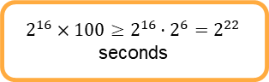
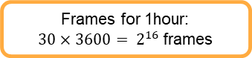
Inference Time Bottleneck
Issue: High inference time. Not suitable for real-time CCTV analysis.
Millions of frames = Significant delay.
CNN
Convolutional Neural Network
CCTV
Firearm?
(YES/NO)
Standard CCTV frame rate is 30FPS
Inference GPU time: 100s for a single image
$2^{16}×100≥2^{16}⋅2^{6}=2^{22}$ seconds
Frames for 1hour:
$30×3600= 2^{16}$frames
~85days

Slide 7
Solution #1: Choose a subset of the frames
Choose a subset of the frame wisely
Infer only the chosen subset

Slide 8
Research question: How we choose the subset?
Suggestions to examine:
Choose frames randomly according to uniform distribution
Check other distributions, and find their optimal parameters.
Find optimal parameters of the distribution such that the prerequisites of GT continue to hold after the selection.
Make pixel by pixel average
Is this computationally expensive?
Making averages on a subset that was randomly chosen

Slide 9
Solution #2: Reduce inference time
This is an active research topic
Directions considered here are related sometimes of using cutting edge hardware..
NVEDIA HW solutions for AI
Optimizing the structure of the CNN
We will not discuss those, although the solution we are examining will make those solutions even better

Slide 10
Solution #3: Group testing
Image
CNN
Convolutional Neural Network
Firearm? (YES/NO)
Due to the work of:
Weixin Liang, James Zou
Suppose that we can enhance the CNN such that:
Image
CNN
Convolutional Neural Network
Image
Yes: at least one frame includes firearm
No: Firearm clean
Image
Image
Image
Image

Slide 11
Solution #3: Group testing (cont.)
Image
CNN
Convolutional Neural Network
Image
Yes: at least one firearm frame
No: Firearm clean
Image
Image
Image
Image
How we choose the frames in each group, so we can actually determine the desired ones ????
Due to the work of: Bshouty & Haddad-Zaknoon
Do we really need to identify ALL the frames with firearm image?
Notes:
Add aws

Slide 12
Let’s take a deeper look…
Assume that we have reduced the number frames.
By choosing frames uniformly at random or ..
Making some kind of average on images (for example pixel based average)
We order the chosen frames according to their original timeline.
The blue frames are ones that capture the abnormal event.
They are consecutive, because we ordered the chosen frame according to their time.
We need to determine this time frame within the video
3:00
It is enough to find a single frame that captured the event
4:00

Slide 13
Why Group Testing
Group Testing works well for a small number of defective items; usually, the abnormal frames only account for a small portion of the whole frames.
Abnormal frames are consecutive, so it is enough to find a single frame that captured the event.
Notes:
Make icon

Slide 14
Story 1: poisoned bottle adaptive
Story 2: poisoned bottle non-adaptive
Add the slide about what is adaptive/non-adaptive
Add a slide with the question: what if d>1
Introduce the disjunct matrix
The decoding alg.
Slide on random vs. det
Give the 4 randomized models

Slide 15
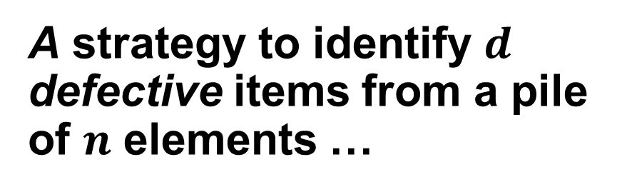
What is Group Testing?
A strategy to identify $d$ defective items from a pile of $n$ elements …
… by testing groups of items rather than testing each one individually.

Slide 16
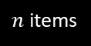
What is Group Testing?
YES (positive)
NO (negative)
$n$ items
A group test is a subset of elements form the pile.
A group test result is positive
if there is at least one “red” (defective) item in this subset and negative otherwise.
Target: identify the set of defective items using minimum number of group tests

Slide 17



Example : The king and the wine riddle
The King of a small country invites 1000 senators to his annual party.
Each senator brings the King a bottle of wine.
The queen discovers that one of the senators is trying to assassinate the King by giving him a bottle of poisoned wine
Unfortunately, they do not know which bottle of wine is poisoned, and the poison is completely indiscernible.
The King has 10 prisoners he plans to execute. He decides to use them as taste testers to determine which bottle of wine contains the poison.

Slide 18

Poisoned?
24 hours
Yes
No
Proceed with left group
Proceed with right group

Slide 19
New limitations of the ri

Slide 20
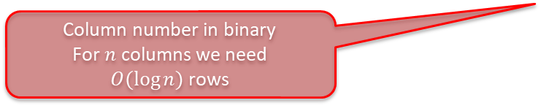
Bottle # | 1 | 2 | 3 | 4 | 5 | 6 | 7 | 8 | 9 | 10 | 11 | … | 1000
Prisoner #1 | 0 | 0 | 0 | 0 | 0 | 0 | 0 | 0 | 0 | 0 | 0 | … | 1
Prisoner #2 | 0 | 0 | 0 | 0 | 0 | 0 | 0 | 0 | 0 | 0 | 0 | … | 1
Prisoner #3 | 0 | 0 | 0 | 0 | 0 | 0 | 0 | 0 | 0 | 0 | 0 | … | 1
Prisoner #4 | 0 | 0 | 0 | 0 | 0 | 0 | 0 | 0 | 0 | 0 | 0 | … | 1
Prisoner #5 | 0 | 0 | 0 | 0 | 0 | 0 | 0 | 0 | 0 | 0 | 0 | … | 1
Prisoner #6 | 0 | 0 | 0 | 0 | 0 | 0 | 0 | 0 | 0 | 0 | 0 | … | 0
Prisoner #7 | 0 | 0 | 0 | 0 | 0 | 0 | 0 | 1 | 1 | 1 | 1 | … | 1
Prisoner #8 | 0 | 0 | 0 | 1 | 1 | 1 | 1 | 0 | 0 | 0 | 0 | … | 0
Prisoner #9 | 0 | 1 | 1 | 0 | 0 | 1 | 1 | 0 | 0 | 1 | 1 | … | 0
Prisoner #10 | 1 | 0 | 1 | 0 | 1 | 0 | 1 | 0 | 1 | 0 | 1 | … | 0
Column number in binary
For $n$ columns we need $O(log⁡n)$rows
Each row indicates a mixture (A single cocktail)
1 – used in the cocktail
0- not used in the cocktail

Slide 21
Results vectors = binary code of the poisoned bottle
Bottle # | 1 | 2 | 3 | 4 | 5 | 6 | 7 | 8 | 9 | 10 | … | 1000
Prisoner #1 | 0 | 0 | 0 | 0 | 0 | 0 | 0 | 0 | 0 | 0 | … | 1
Prisoner #2 | 0 | 0 | 0 | 0 | 0 | 0 | 0 | 0 | 0 | 0 | … | 1
Prisoner #3 | 0 | 0 | 0 | 0 | 0 | 0 | 0 | 0 | 0 | 0 | … | 1
Prisoner #4 | 0 | 0 | 0 | 0 | 0 | 0 | 0 | 0 | 0 | 0 | … | 1
Prisoner #5 | 0 | 0 | 0 | 0 | 0 | 0 | 0 | 0 | 0 | 0 | … | 1
Prisoner #6 | 0 | 0 | 0 | 0 | 0 | 0 | 0 | 0 | 0 | 0 | … | 0
Prisoner #7 | 0 | 0 | 0 | 0 | 0 | 0 | 0 | 1 | 1 | 1 | … | 1
Prisoner #8 | 0 | 0 | 0 | 1 | 1 | 1 | 1 | 0 | 0 | 0 | … | 0
Prisoner #9 | 0 | 1 | 1 | 0 | 0 | 1 | 1 | 0 | 0 | 1 | … | 0
Prisoner #10 | 1 | 0 | 1 | 0 | 1 | 0 | 1 | 0 | 1 | 0 | … | 0
0
0
0
0
0
0
0
1
0
1
After 24h
Poisonous cocktails are the ones who has samples from bottle no. 5
Define:
Poisoned = 1
Healthy = 0

Slide 22
Discussion
Bottle # | 1 | 2 | 3 | 4 | 5 | 6 | 7 | 8 | 9 | 10 | … | 1000
Prisoner #1 | 0 | 0 | 0 | 0 | 0 | 0 | 0 | 0 | 0 | 0 | … | 1
Prisoner #2 | 0 | 0 | 0 | 0 | 0 | 0 | 0 | 0 | 0 | 0 | … | 1
Prisoner #3 | 0 | 0 | 0 | 0 | 0 | 0 | 0 | 0 | 0 | 0 | … | 1
Prisoner #4 | 0 | 0 | 0 | 0 | 0 | 0 | 0 | 0 | 0 | 0 | … | 1
Prisoner #5 | 0 | 0 | 0 | 0 | 0 | 0 | 0 | 0 | 0 | 0 | … | 1
Prisoner #6 | 0 | 0 | 0 | 0 | 0 | 0 | 0 | 0 | 0 | 0 | … | 0
Prisoner #7 | 0 | 0 | 0 | 0 | 0 | 0 | 0 | 1 | 1 | 1 | … | 1
Prisoner #8 | 0 | 0 | 0 | 1 | 1 | 1 | 1 | 0 | 0 | 0 | … | 0
Prisoner #9 | 0 | 1 | 1 | 0 | 0 | 1 | 1 | 0 | 0 | 1 | … | 0
Prisoner #10 | 1 | 0 | 1 | 0 | 1 | 0 | 1 | 0 | 1 | 0 | … | 0
What makes this solution work?
Is this the only way to design the cocktails?
Does the solution work if we only had 9 prisoners?
0
0
0
0
0
0
0
1
0
1
Can we still distinguish between bottle #5 and #7?
0

Slide 23
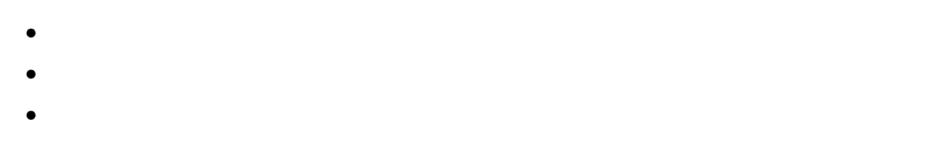
So far …
We have$n$items
Among which we have $d=1$ defective item
Target: Identify the defective item (sick soldier, poisoned bottle)
Strategy #1
Strategy #2
Define a single group test
Perform the group test
Upon getting the result, decided on your next test
Adaptive strategy
Define ALL group tests in advance
Perform all the group tests in parallel
Upon getting the results, decode the result WITHOUT any further testing
Non-adaptive strategy

Slide 24
Add a slide with the question: what if d>1

Slide 25
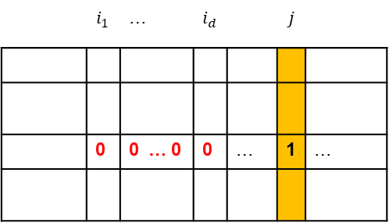
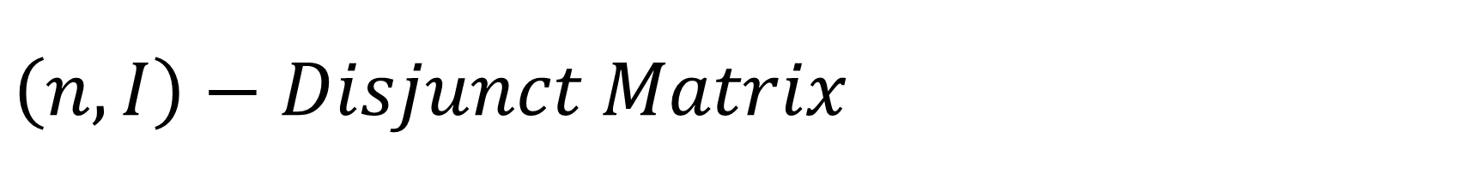

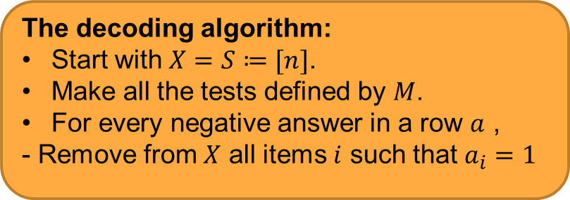
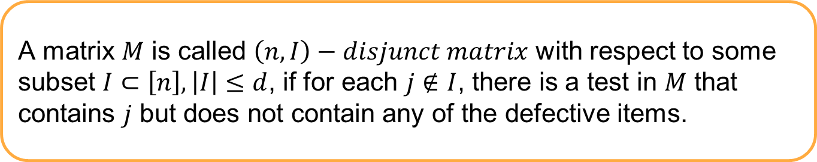
$$\left(n,I\right)−Disjunct Matrix$$
A matrix $M$ is called $\left(n,I\right)−disjunct matrix$ with respect to some subset $I⊂\left[n\right], \left|I\right|≤d$, if for each $j∉I$, there is a test in $M$ that contains $j$ but does not contain any of the defective items.
The decoding algorithm:
Start with $X=S≔[n]$.
Make all the tests defined by $M$.
For every negative answer in a row $a$ ,
- Remove from $X$ all items $i$ such that $a_{i}=1$
 | $$i_{1}$$ | … | $$i_{d}$$ |  | $$j$$
 | 0 | 0 … 0 | 0 | … | 1 | …
Such test guarantees to eliminate $j$ from $X$.

Slide 26
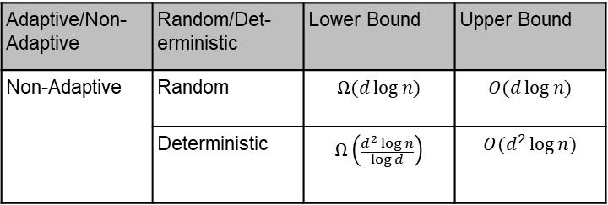
Random vs. Deterministic Non adaptive Algorithms for GT
In practice, tests are time consuming, therefore, non-adaptive algorithms are highly desired.
Lower bound for non-adaptive deterministic vs. non-adaptive random algorithm motivates the interest in non-adaptive random algorithms.
In many studies, optimality in the number of tests is “chased” up to the leading constant.
Adaptive/Non-Adaptive | Random/Det-erministic | Lower Bound | Upper Bound
Non-Adaptive | Random | $$Ω(d\log{n)}$$ | $$O(d\log{n)}$$
 | Deterministic | $$Ω\left(\frac{d^{2}\log{n}}{\log{d}}\right)$$ | $$O(d^{2}\log{n)}$$
Notes:
In practice, tests are time consuming and therefore nonadaptive algorithms are highly desired. Where by non-adaptive algorithm we mean that the tests are independent, that is, the decision of making a specific test does not involve the results of previous tests.
In the table we summarize the known lower and upper bound on the number of tests required to identify at most d defectives. And we can see the advantage of the random non-adaptive algorithms over the deterministic ones… this actually motivates our interest in non-adaptive random algorithms for GT.
Practically, the tests might take one-two days till getting the results, therefore, many studies including ours, focus their efforts on reducing the hidden constants in the O and omega notations.

Slide 27
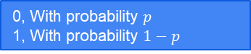
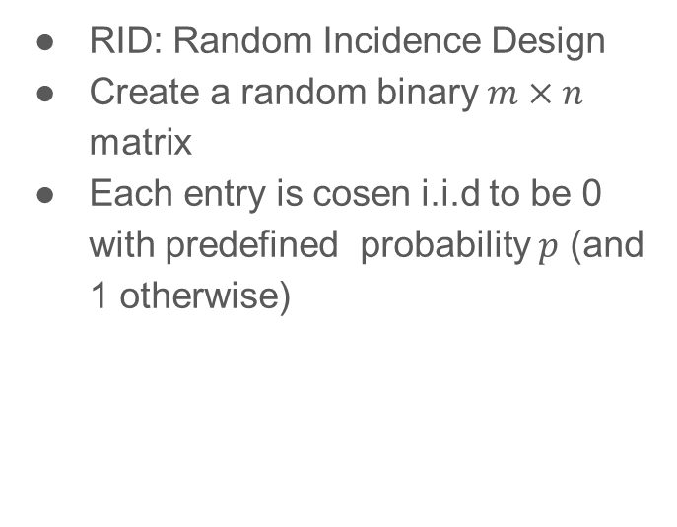
Pool Design Models: RID
RID
RID: Random Incidence Design
Create a random binary $m×n$ matrix
Each entry is cosen i.i.d to be 0 with predefined probability $p$ (and 1 otherwise)
 | …
 | …
. .
 | …
0, With probability $p$
1, With probability $1−p$

Slide 28
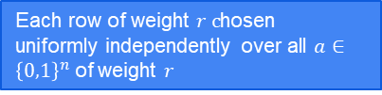
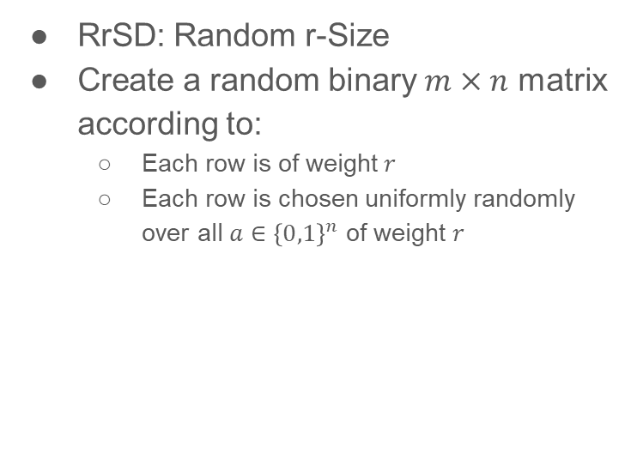
Pool Design Models: RrSD
RrSD: Random r-Size
Create a random binary $m×n$ matrix according to:
Each row is of weight$r$
Each row is chosen uniformly randomly over all $a∈{\left\{0,1\right\}}^{n}$ of weight $r$
RrSD
. .
Each row of weight $r c$hosen uniformly independently over all $a∈{\left\{0,1\right\}}^{n}$ of weight $r$

Slide 29
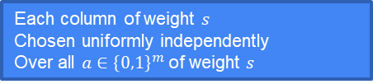
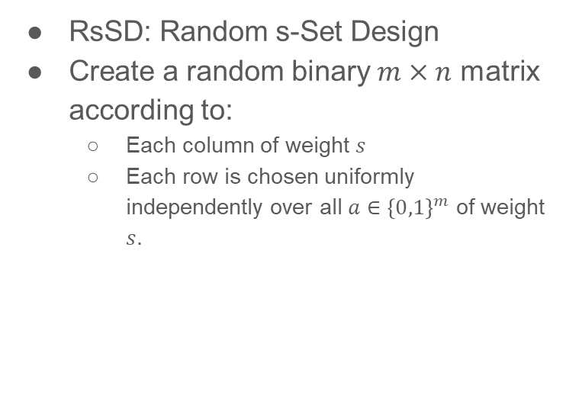
Pool Design Models: RsSD
RsSD
RsSD: Random s-Set Design
Create a random binary $m×n$ matrix according to:
Each column of weight $s$
Each row is chosen uniformly independently over all $a∈{\left\{0,1\right\}}^{m}$ of weight $s$.
 | … |  | …
Each column of weight $s$
Chosen uniformly independently
Over all $a∈{\left\{0,1\right\}}^{m}$ of weight $s$

Slide 30
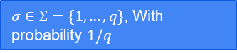
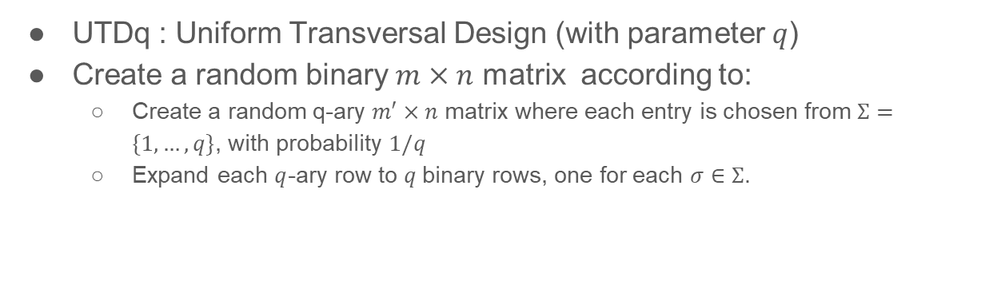
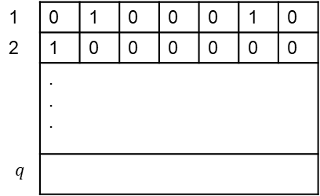
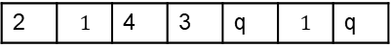
Pool Design Models: UTDq
UTDq : Uniform Transversal Design (with parameter $q$)
Create a random binary $m×n$ matrix according to:
Create a random q-ary $m′×n$ matrix where each entry is chosen from $Σ=\{1,…, q\}$, with probability $1/q$
Expand each $q$-ary row to $q$binary rows, one for each $σ∈Σ$.
UTDq
1 | 0 | 1 | 0 | 0 | 0 | 1 | 0
2 | 1 | 0 | 0 | 0 | 0 | 0 | 0
 | . . .
$$q$$
 | …
 | …
. .
 | …
$σ∈Σ=\{1,…, q\}$, With probability $1/q$
2 | $$1$$ | 4 | 3 | q | $$1$$ | q

Slide 31
Recall ..
Image
CNN
Convolutional Neural Network
Image
Yes: at least one frame includes firearm
No: Firearm clean
Image
Image
Image
Image

Slide 32
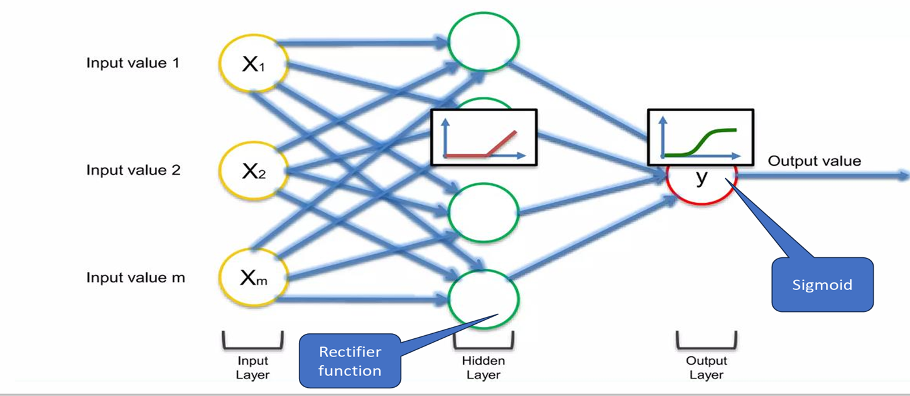
The structure of Neural Network

Slide 33
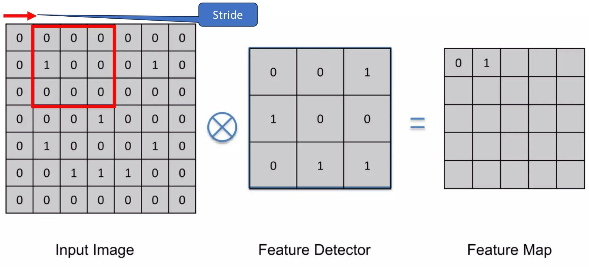
Convolution:
Notes:
additional layers, function

Slide 34
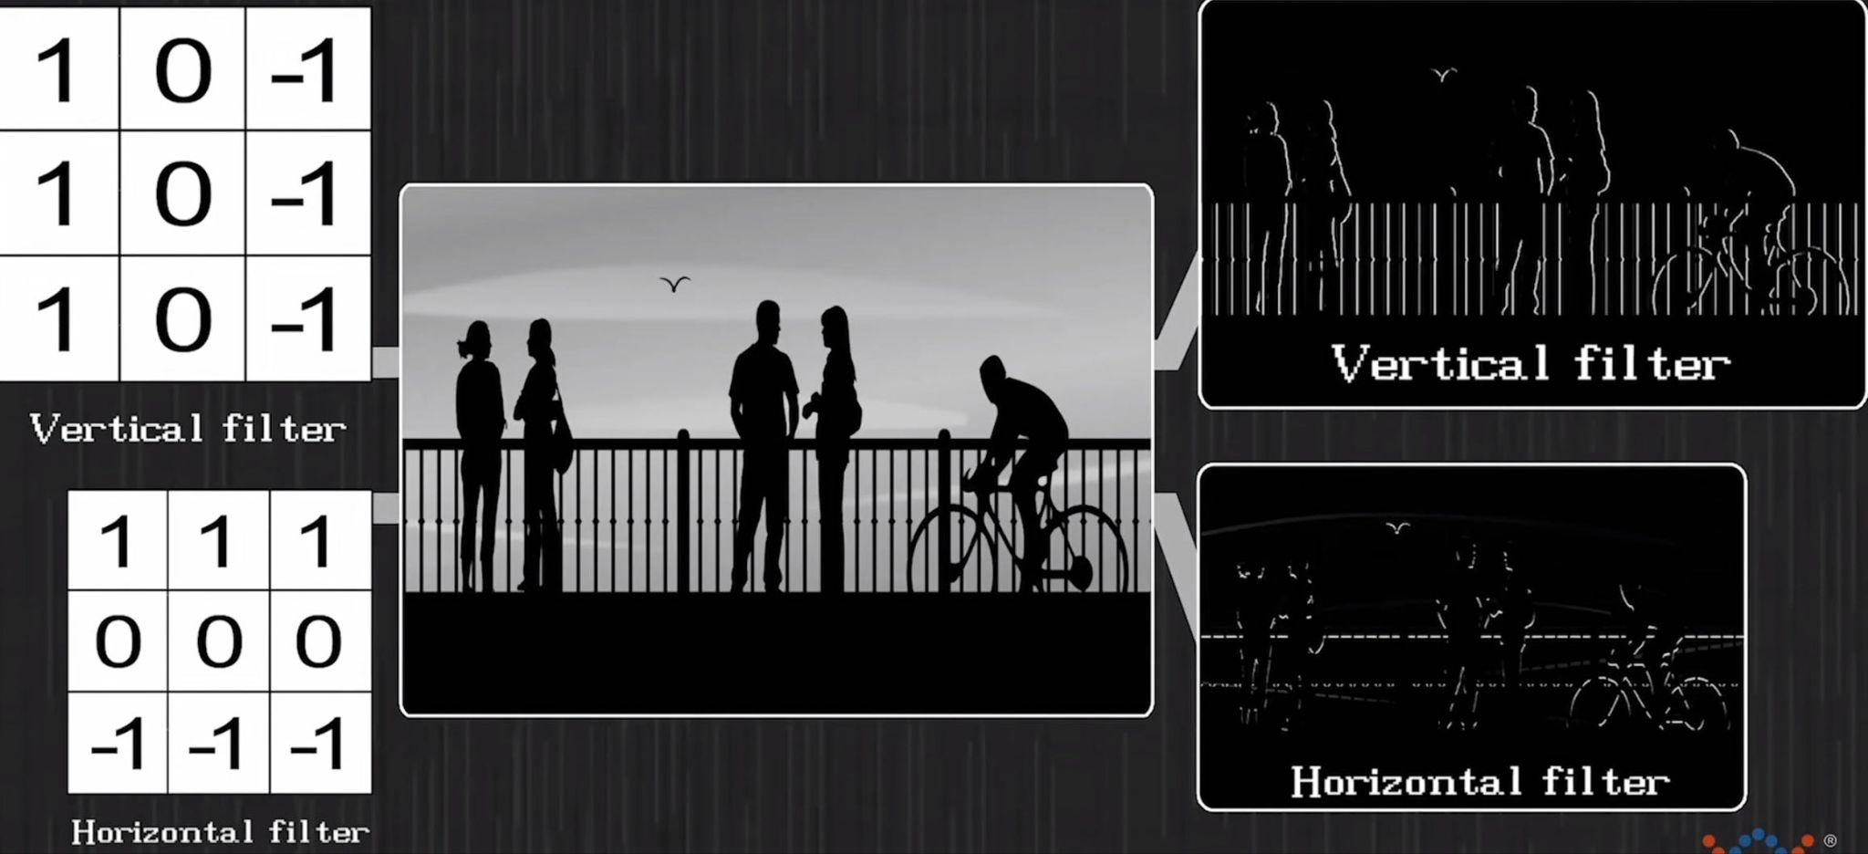
Example:

Slide 35
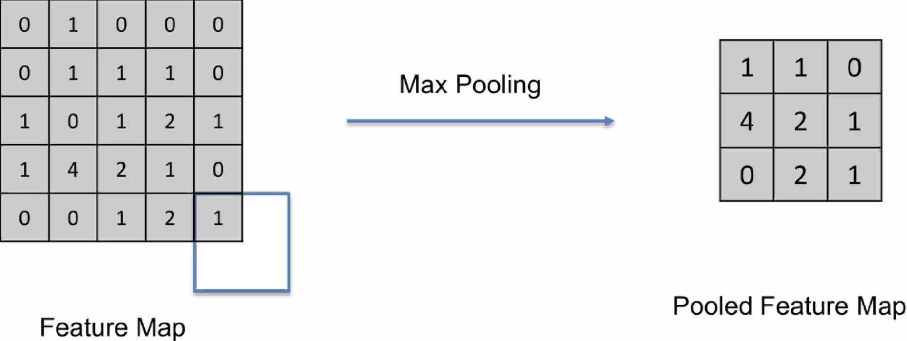
Pooling:

Slide 36
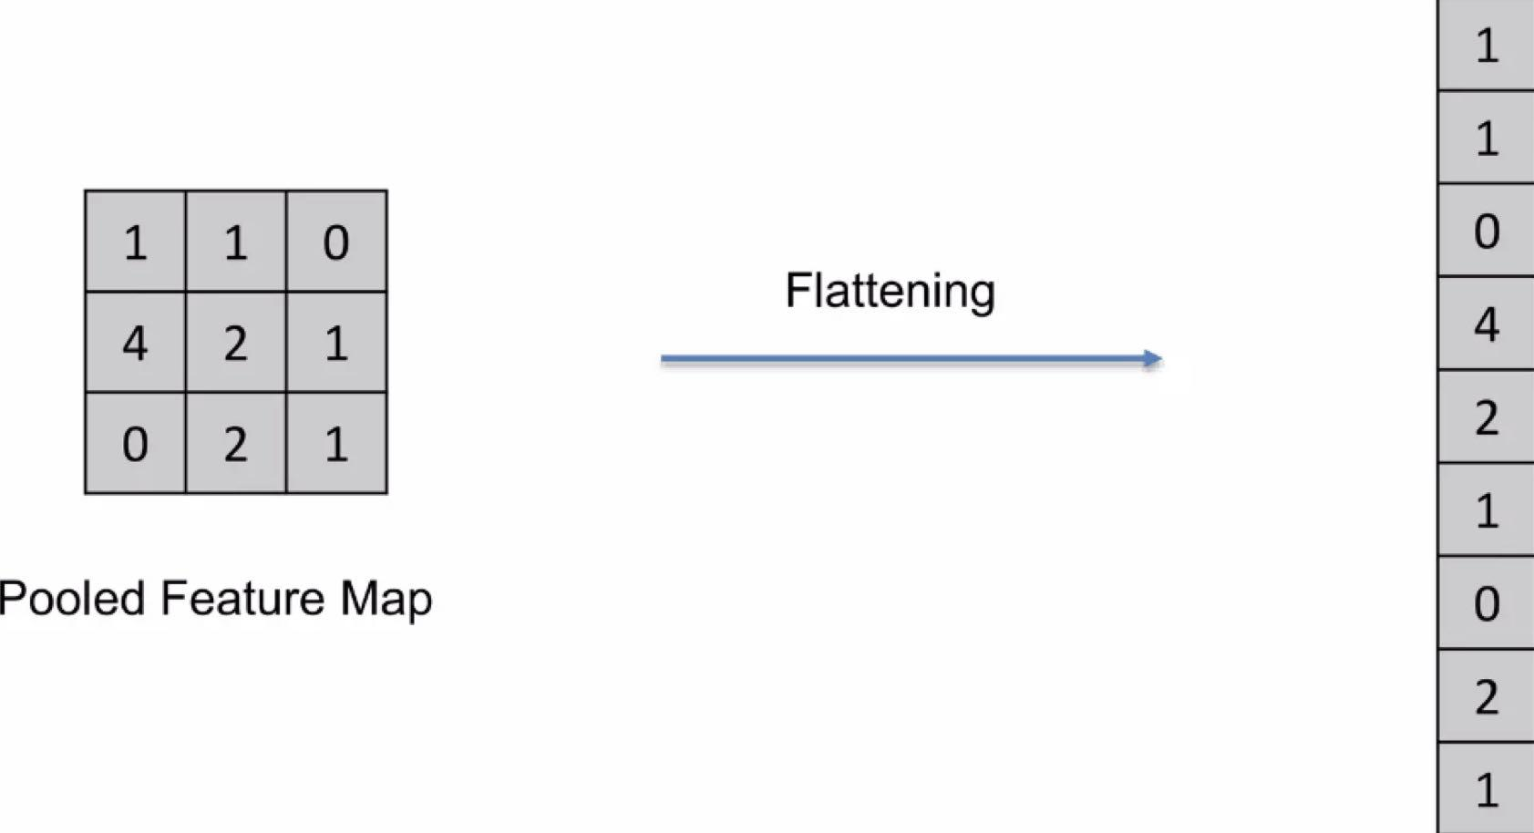
Flatening:

Slide 37
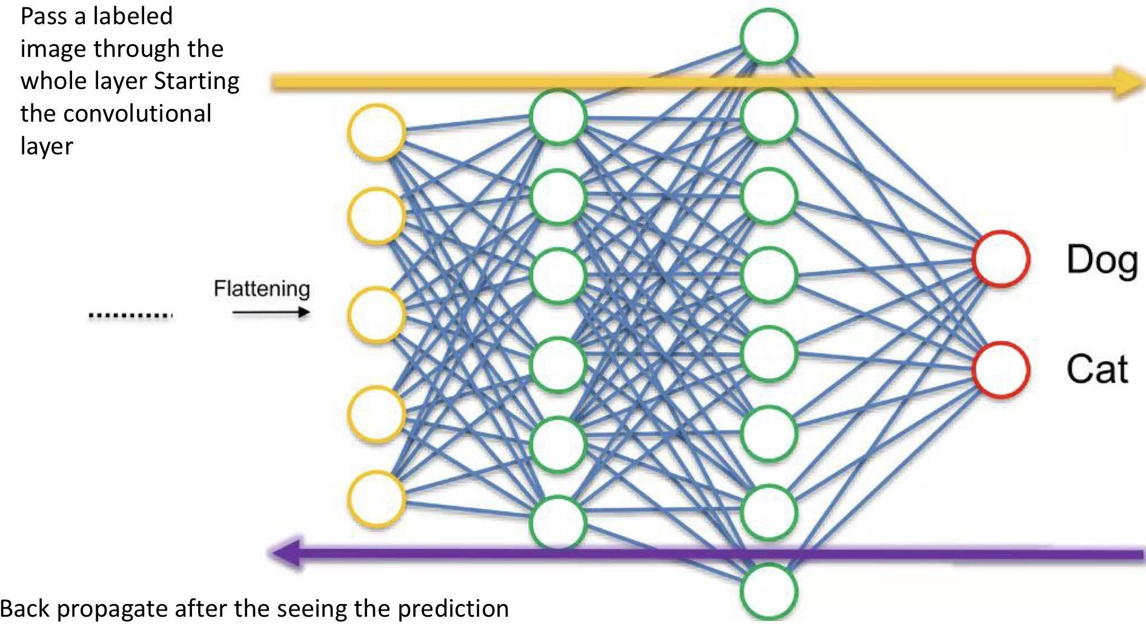
Fully connected NN:

Slide 38
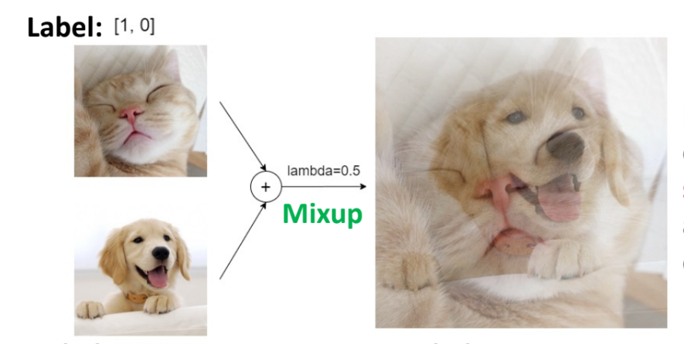
Average of photos,
Notes:
Incentive, group images

Slide 39
GT and CNN marriage
Notes:
Three designs, copy

Slide 40
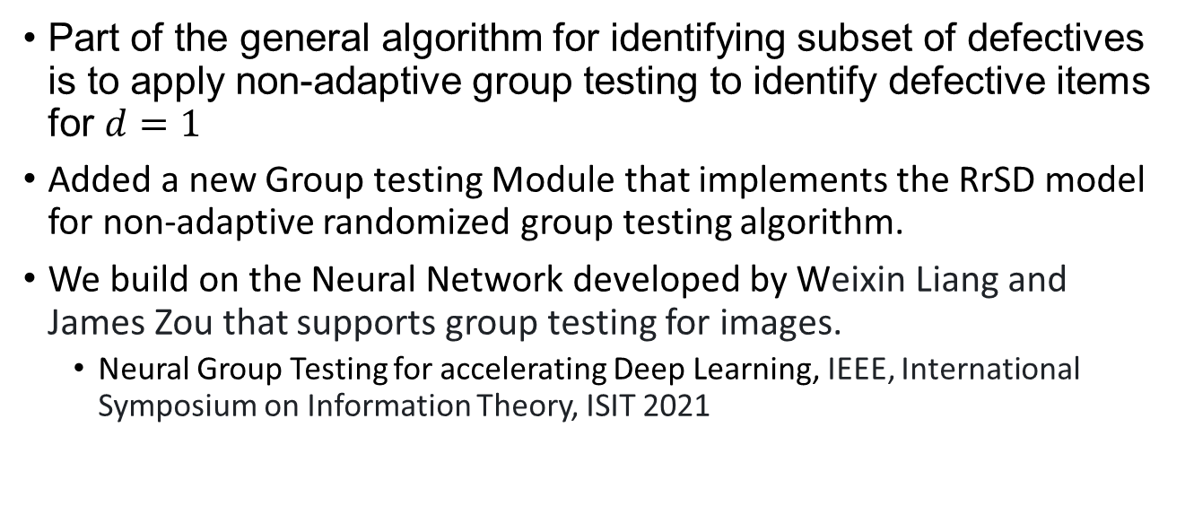
Our Work
Part of the general algorithm for identifying subset of defectives is to apply non-adaptive group testing to identify defective items for $d=1$
Added a new Group testing Module that implements the RrSD model for non-adaptive randomized group testing algorithm.
We build on the Neural Network developed by Weixin Liang and James Zou that supports group testing for images.
Neural Group Testing for accelerating Deep Learning, IEEE, International Symposium on Information Theory, ISIT 2021

Slide 41
Methods
Programming language: python
Version control system Git and GitHub
Training Server:
96 Intel(R) Xeon(R) Gold 6336Y CPU @ 2.40GHz 503GB RAM 8 x NVIDIA A40 – 49GB
Traning Set: Imagenet (dataset of over 14 million hand-annotated images. )

Slide 42
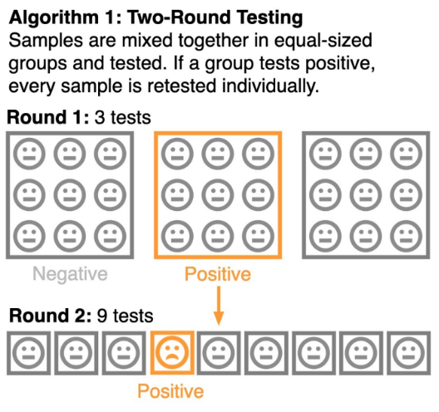
GT in the original work: 2-round group testing
Round 1:
Divide the images into distinct groups and tests
Round 2:
For each positive group, test each image individually.

Slide 43
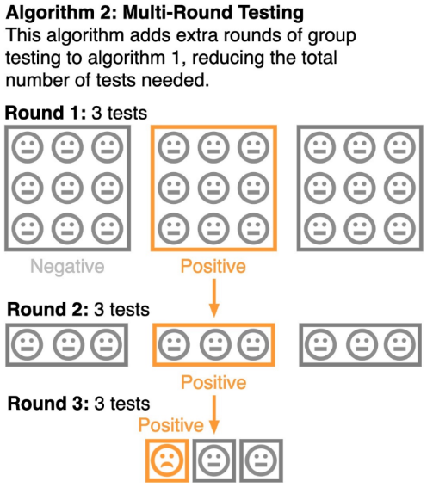
GT in the original work: Multi-round group testing
Round 1:
Divide the images into distinct groups and tests
Round 2:
Split the positive group into smaller distinct groups and test.
Round 3:
Test images in positive groups one by one.

Slide 44
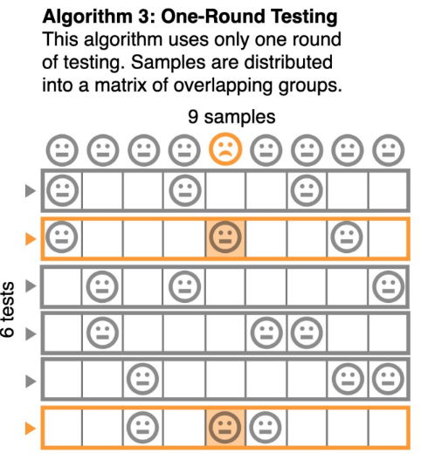
GT in the original work: Non-adaptive GT (deterministic)
Divide the images into distinct groups of a fixed TWICE
Each item will be included in TWO groups
An item is positive if both groups it participated in are positive.

Slide 45
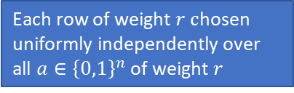
Implementing RrSD model: Creating the matrix
RrSD
Implemented the method:
GroupTestingRrSD_ValLoader
. .
Each row of weight $r c$hosen uniformly independently over all $a∈{\left\{0,1\right\}}^{n}$ of weight $r$

Slide 46
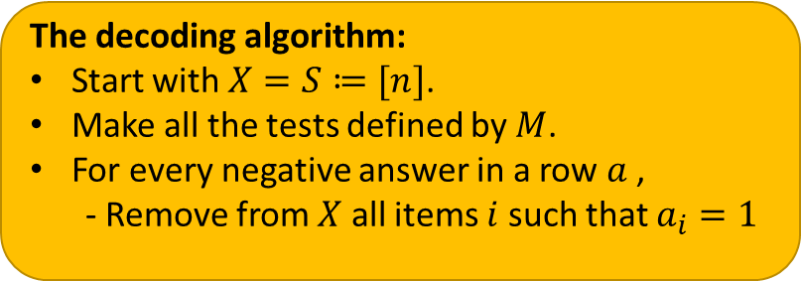
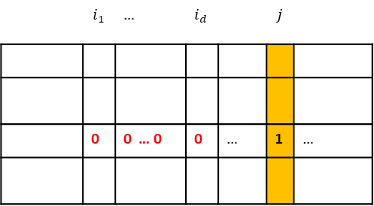
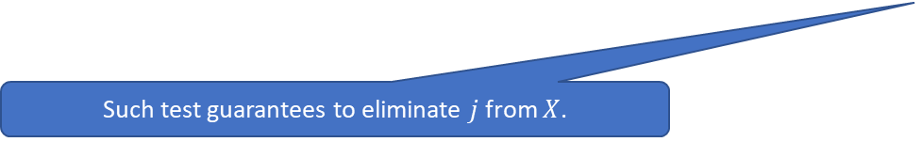
Implementing RrSD model: Creating the wrapper function
Implemented a wrapper function:
Responsible for processing the results and decoding the fire-arm images.
Measures the performance of the decoding compared to single image by image testing
 | $$i_{1}$$ | … | $$i_{d}$$ |  | $$j$$
 | 0 | 0 … 0 | 0 | … | 1 | …
The decoding algorithm:
Start with $X=S≔[n]$.
Make all the tests defined by $M$.
For every negative answer in a row $a$ ,
- Remove from $X$ all items $i$ such that $a_{i}=1$
Such test guarantees to eliminate $j$ from $X$.

Slide 47
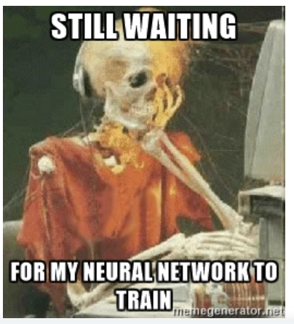
Real results on the trained model

Slide 48
Building Simulator

Slide 49
Why We Need This
Model training is time-consuming.
Our primary objective is to evaluate the performance of our group testing algorithm.

Slide 50
What We Do
Simulate the model's expected output to approximate a model with a 90% accuracy rate.

Slide 51
How the Simulator Works
Target
Simulator
Accuracy
Images
Group Test
Output

Slide 52
Further direction to investigate
Further investigate the performance of group testing algorithms on these settings.
Can we adopt the trained CNNs to work with any size of group?
To make real-world identification of firearm, the CNN should be trained on images from surveillance cameras rather than high resolution dataset like ImageNet.

Slide 53
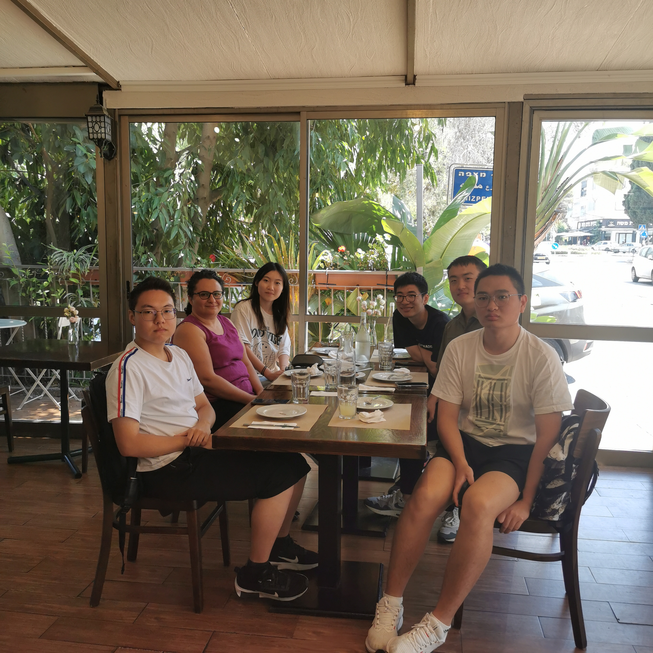
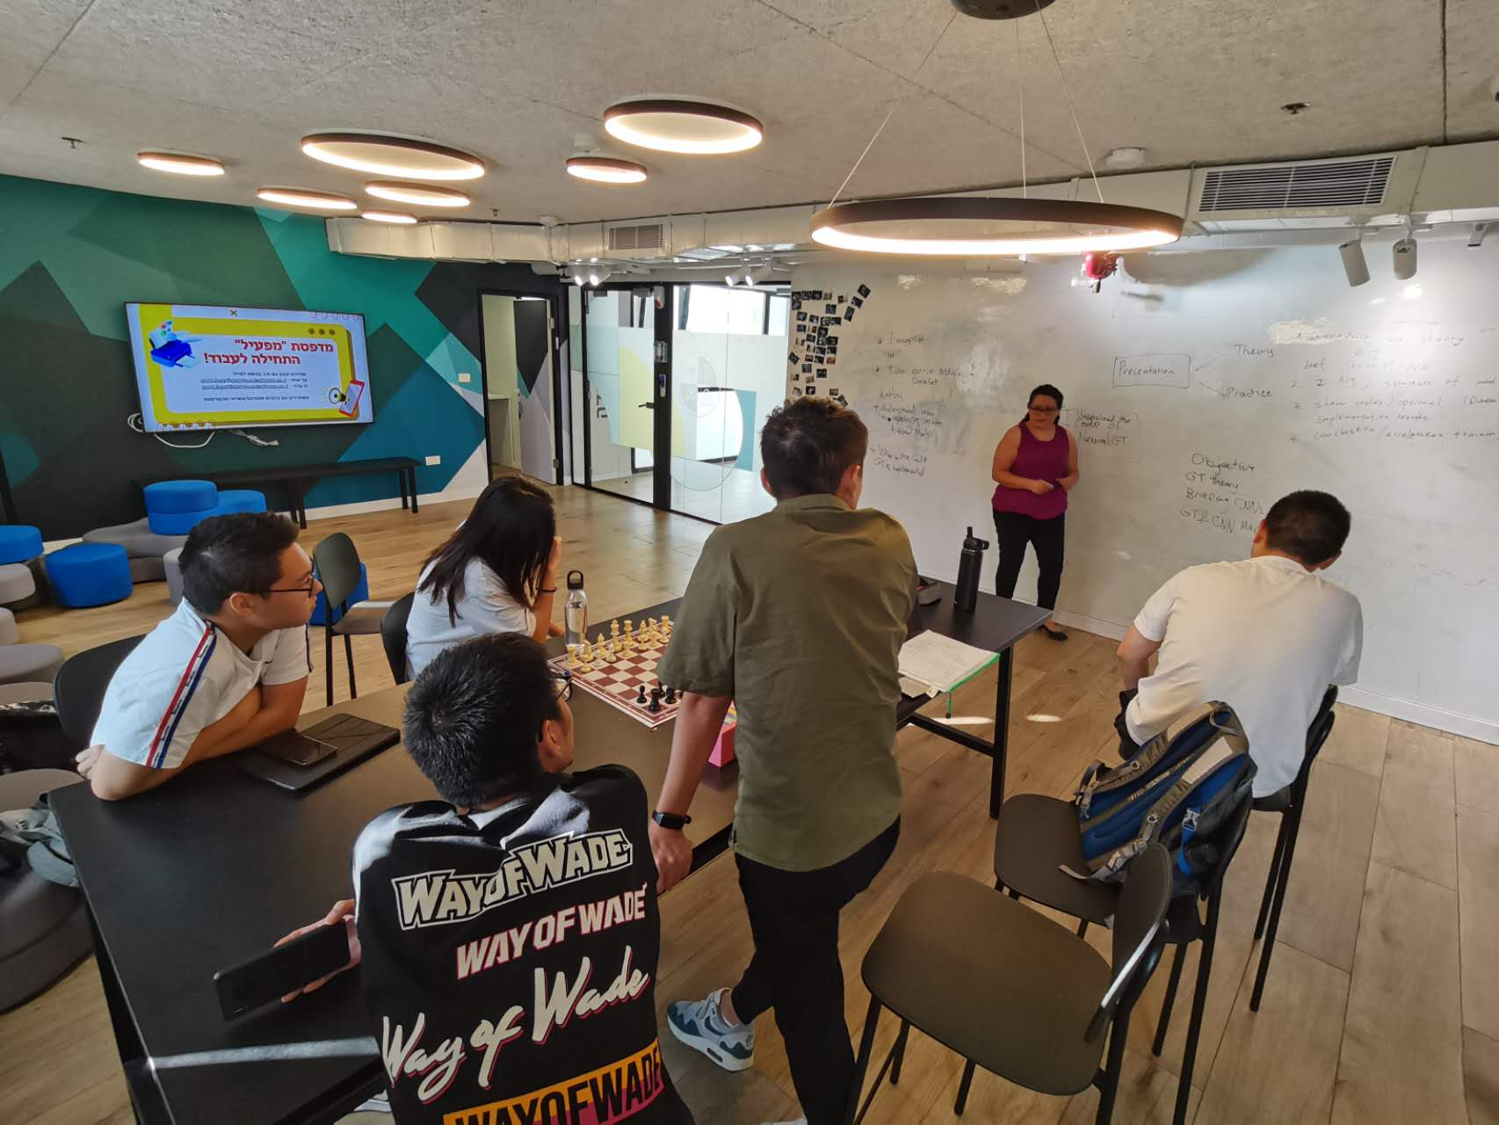
Thank you!

